Slide 1


KS4 Mathematics
N4 Upper and lower bounds

Slide 2

Discrete and continuous quantities
Numerical data can be discrete or continuous.
Discrete data can only take certain values.
For example,
shoe sizes,
the number of children in a class,
amounts of money
Continuous data comes from measuring and can take any value within a given range.
For example,
the weight of a banana,
the time it takes for pupils to get to school,
heights of 15 year-olds.

Slide 3
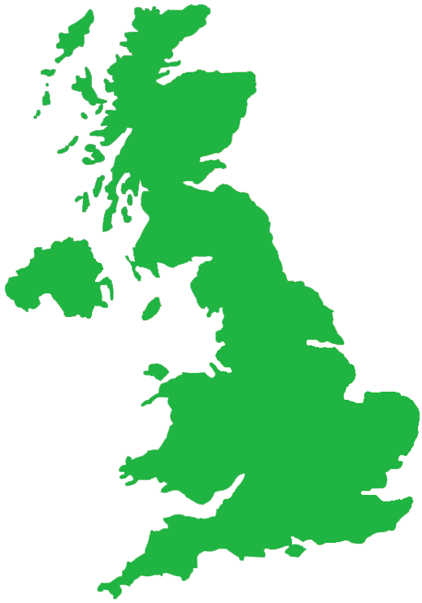
Upper and lower bounds for discrete data
The population of the United Kingdom is 59 million to the nearest million.
What is the least this number could be?
The least this number could be before being rounded up is:
58 500 000
What is the most this number could be?
The most this number could be before being rounded down is:
59 499 999
Notes:
Discuss the fact that if the population has been given to the nearest million the actual amount could be half a million more or less either way. Because of the convention of rounding up when a number is half way between two others, the most the population could be is 59 500 000 – 1 (= 59 499 999).

Slide 4
Upper and lower bounds
We can give the possible range for the population as:
58 500 000 ≤ population ≤ 59 499 999
This value is called the lower bound …
… and this value is called the upper bound.
This is an inequality. It says that the actual population of the United Kingdom is between 58 500 000 and 59 499 999.
Because we have used ≤ symbols it means that these two numbers are included in the range of possible values. We could also write the range as:
58 500 000 ≤ population < 59 500 000
Notes:
Remind pupils that because the population is discrete data, we can only have whole numbers between the two values given.

Slide 5
Upper and lower bounds for discrete data
Last year a shopkeeper made a profit of £43 250, to the nearest £50.
What range of values could this amount be in?
The lower bound is half-way between £43 200 and £43 250:
£43 225
The upper bound is half-way between £43 250 and £43 300, minus 1p:
£43 274.99
The range for this profit is:
£43 225 ≤ profit ≤ £43 274.99
Notes:
Explain that because the amount has been rounded to the nearest £50, the lower bound must be half-way between the given amount and the given amount – £50.
The upper bound must be half-way between the given amount and the given amount + £50. We then subtract 1p because if the amount was equal to £43 275 it would be rounded up to £43 300. 1p is the smallest amount we can subtract because we consider amounts of money to be discrete since they are given in a whole number pence.

Slide 6

Upper and lower bounds for continuous data
The height of the Eiffel Tower is 324 meters to the nearest meter.
What is the least this measurement could be?
The least this measurement could be before being rounded up is:
323.5 m
What is the most this measurement could be?
The most this measurement could be before being rounded down is up to but not including:
324.5 m

Slide 7
Upper and lower bounds
We can write the range for this measurement as:
323.5 m ≤ height < 324.5 m
This value is called the lower bound …
… and this value is called the upper bound.
The height could be equal to 323.5 m so we use a greater than or equal to symbol.
If the length was equal to 324.5 m however, it would have been rounded up to 325 m. The length is therefore “strictly less than” 324.5 m and so we use the < symbol.
Notes:
We can read the inequality as “the height is between 323.5 m and 324.5 m, but doesn’t include 324.5 m”.
Explain that if the length is strictly less than 324.5 cm, it can be any value up to 324.4999…
It is interesting to note that if we convert 324.49 recurring using the method shown in 4.2 Terminating and recurring decimals, we can show that it is actually equal to 324.5.
See S8.3 Calculations involving bounds to investigate the combined effect of bounds in calculations.

